Slide 1

GW

Slide 2


GW

Slide 3

GW

Slide 5
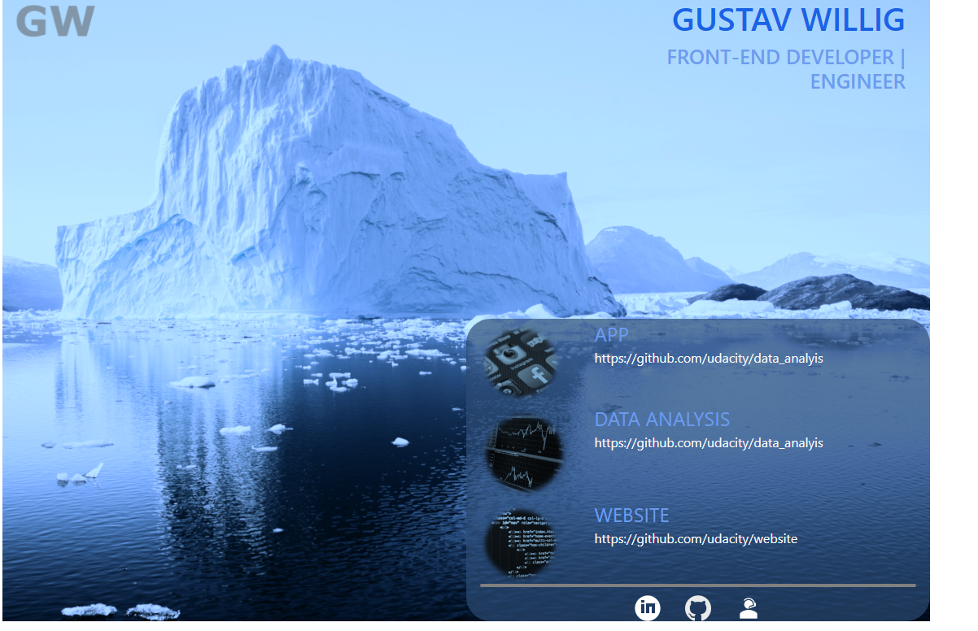

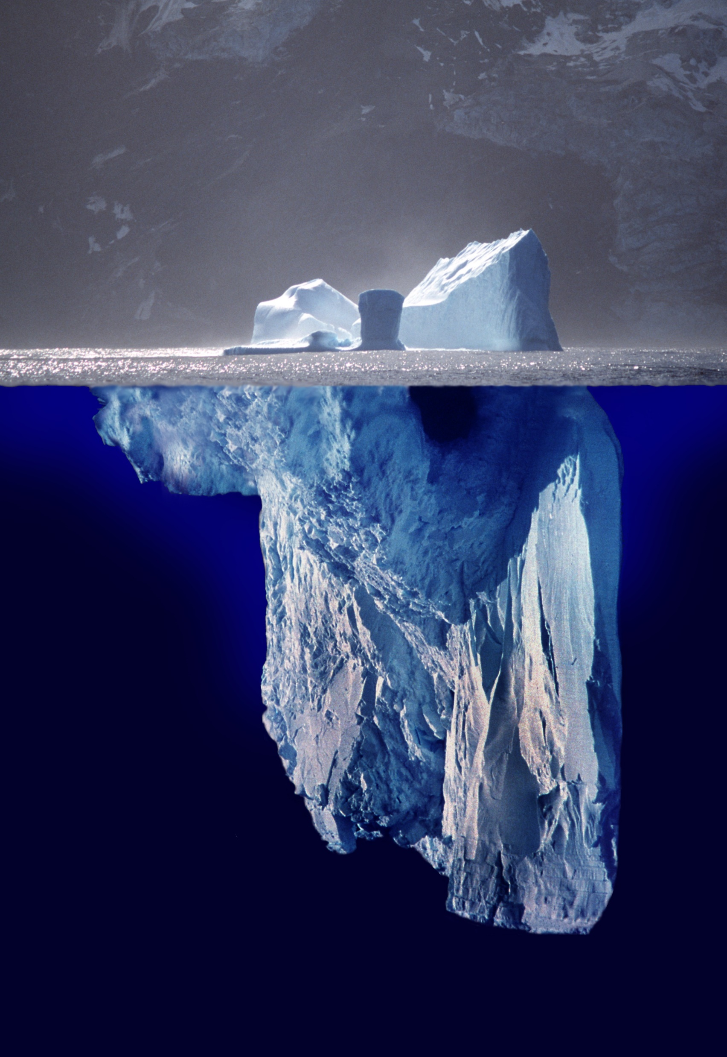





GW
GUSTAV WILLIG
FRONT-END DEVELOPER | ENGINEER
APPIFLY
Appifly
APPIFLY
APPIFLY

Slide 6



GW
GUSTAV WILLIG
FRONT-END DEVELOPER | ENGINEER
APPIFLY
https://github.com/udacity/Appifly
APPIFLY
https://github.com/udacity/Appifly
Data analysis
https://github.com/udacity/Appifly
in
Notes:
https://www.pexels.com/de-de/foto/app-apps-design-elektrik-147413/ https://www.pexels.com/de-de/foto/arbeit-arbeiten-begrifflich-bildschirm-270404/ https://www.pexels.com/de-de/foto/business-computer-diagramm-geschaft-241544/ https://www.pexels.com/de-de/foto/meer-wasser-ozean-winter-48823/ https://unsplash.com/photos/Tno1Zd3T6yY
Photo by Annie Spratt on Unsplash

Slide 7

GW
GUSTAV WILLIG
FRONT-END DEVELOPER | ENGINEER
APPIFLY
https://github.com/udacity/Appifly
APPIFLY
https://github.com/udacity/Appifly
APPIFLY
https://github.com/udacity/Appifly
in

Slide 8
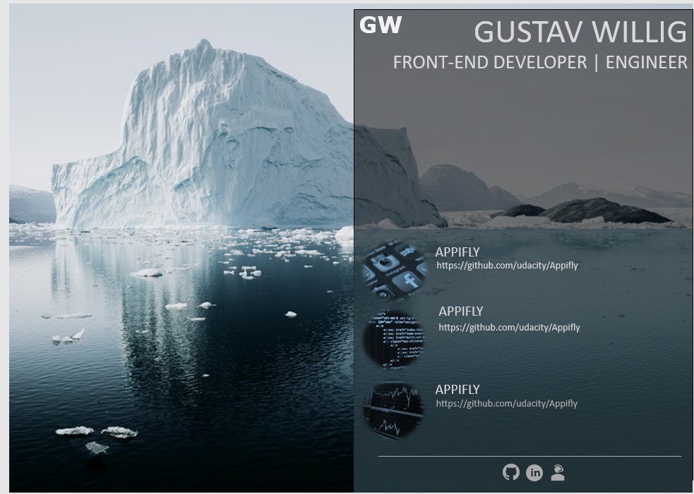

Slide 9
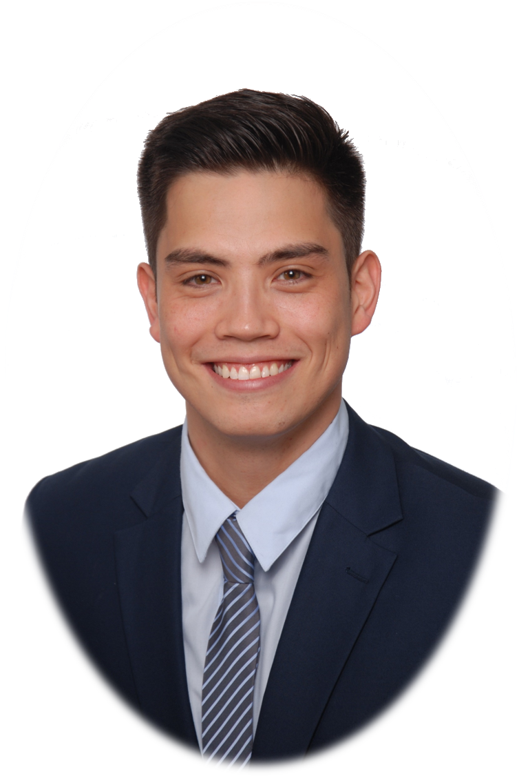
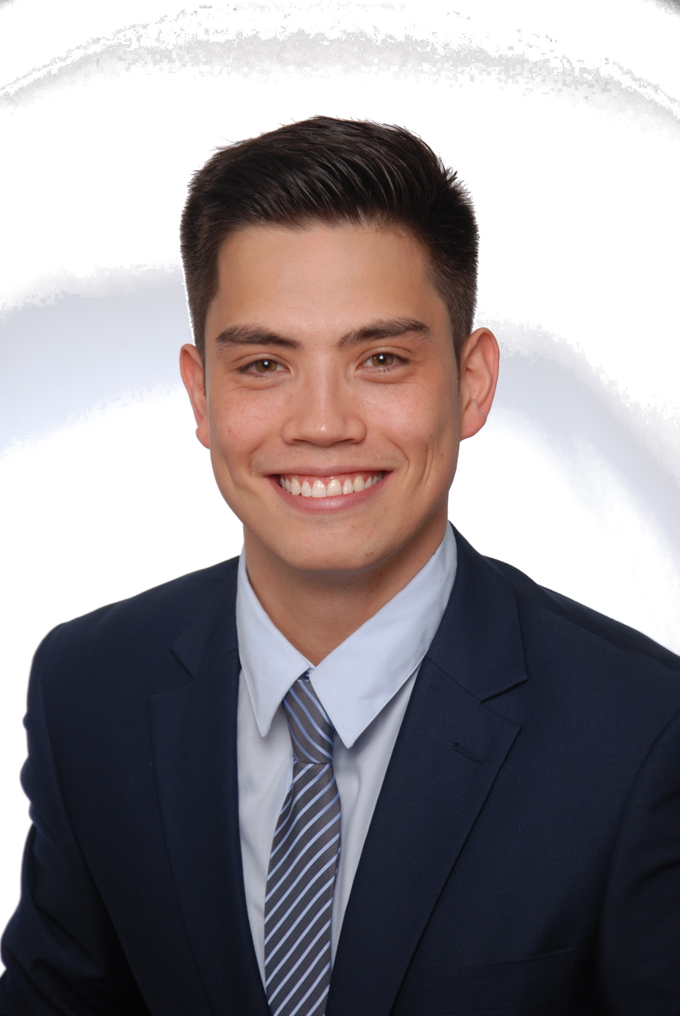
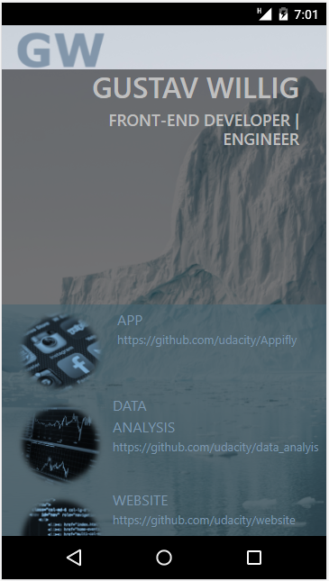
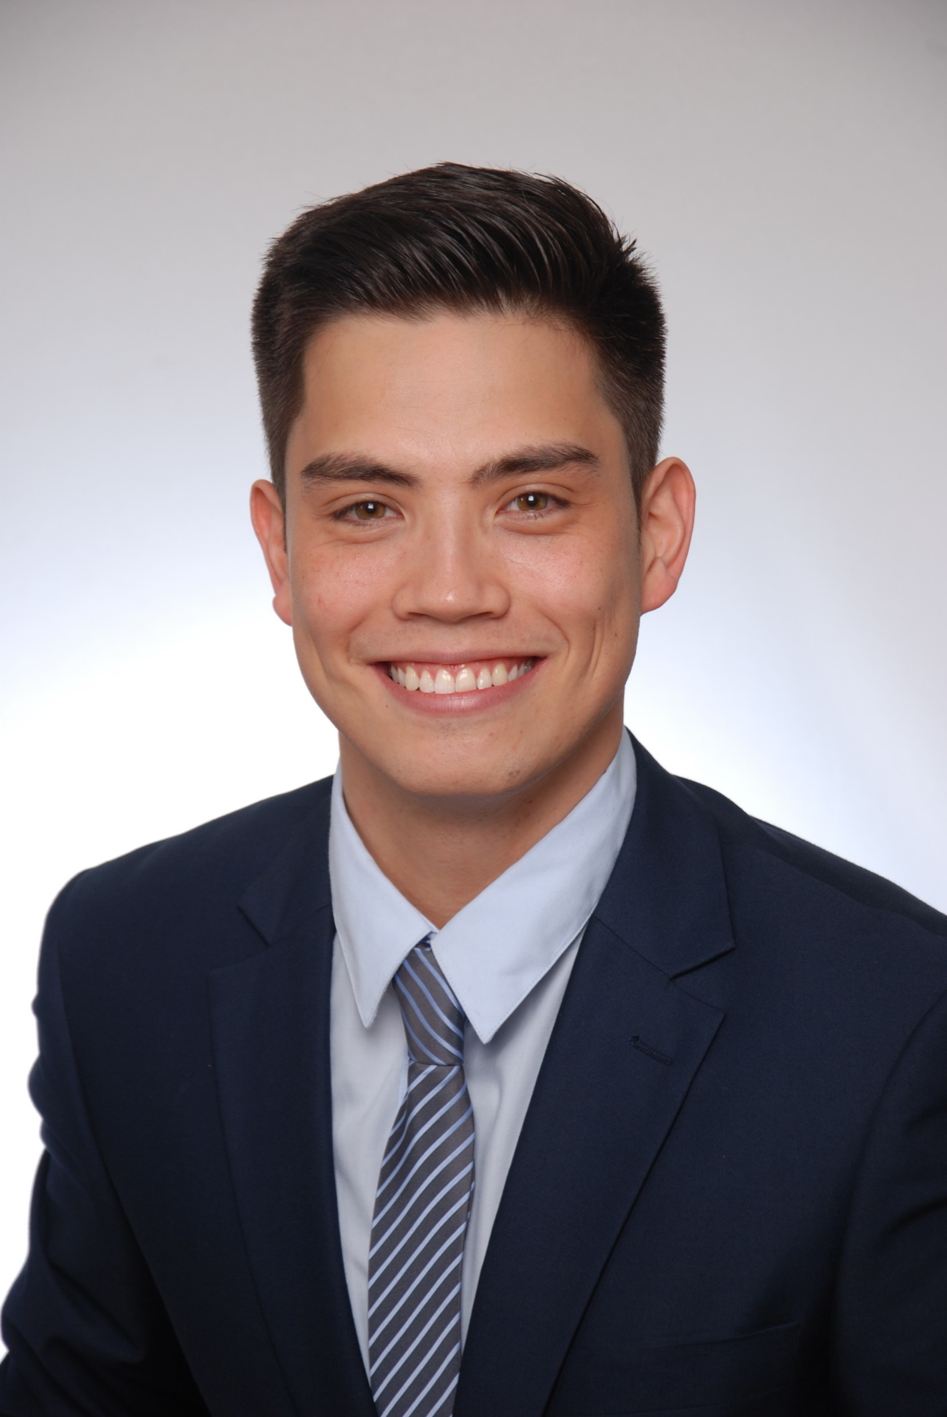

in

Slide 10
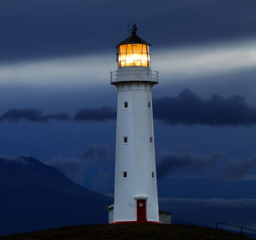
Contact:

